Slide 1
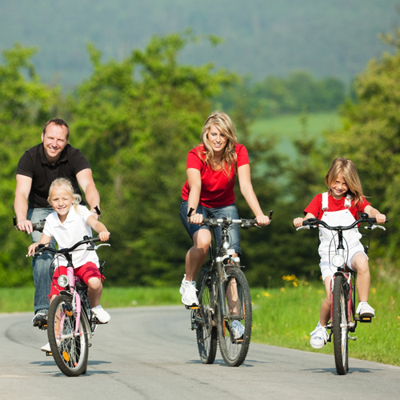
Bicycles in the Netherlands.

Slide 2
The history of the Dutch bicycles.

Slide 3
7 benefits of cycling

Slide 4
handy

Slide 5
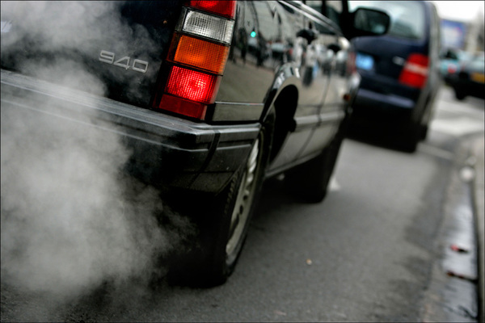
Environmentally

Slide 6
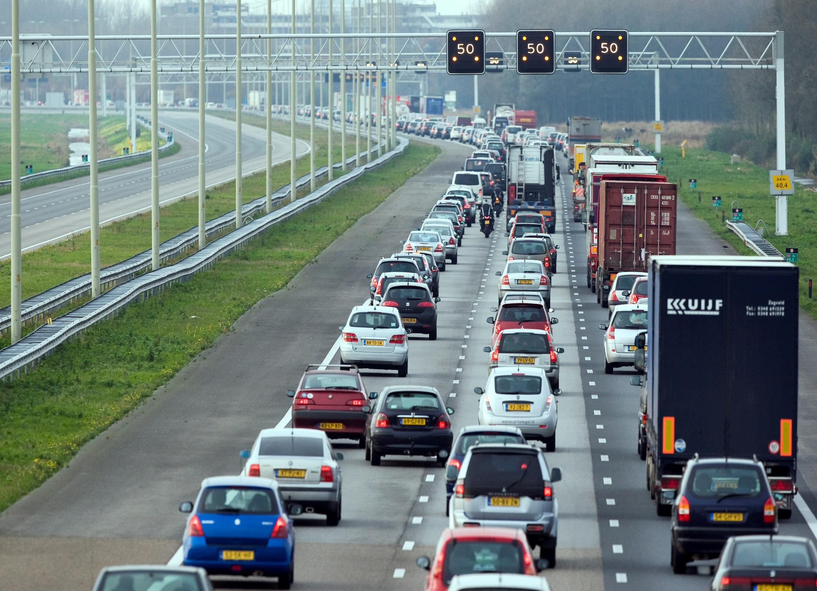
Traffic jam

Slide 7
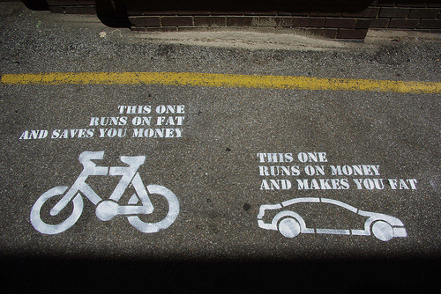
Healthy

Slide 8
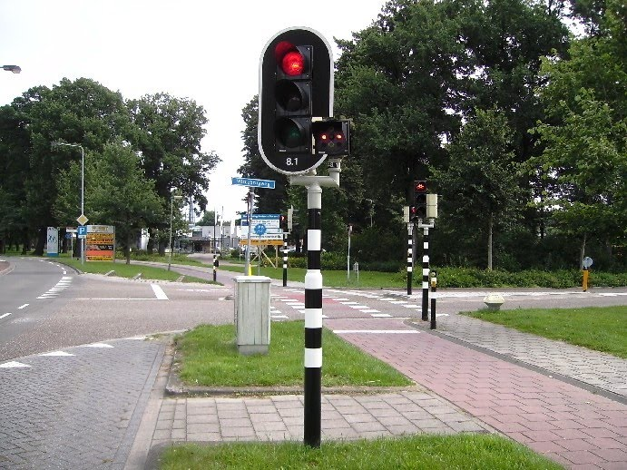
opportunities

Slide 9
cosy

Slide 10
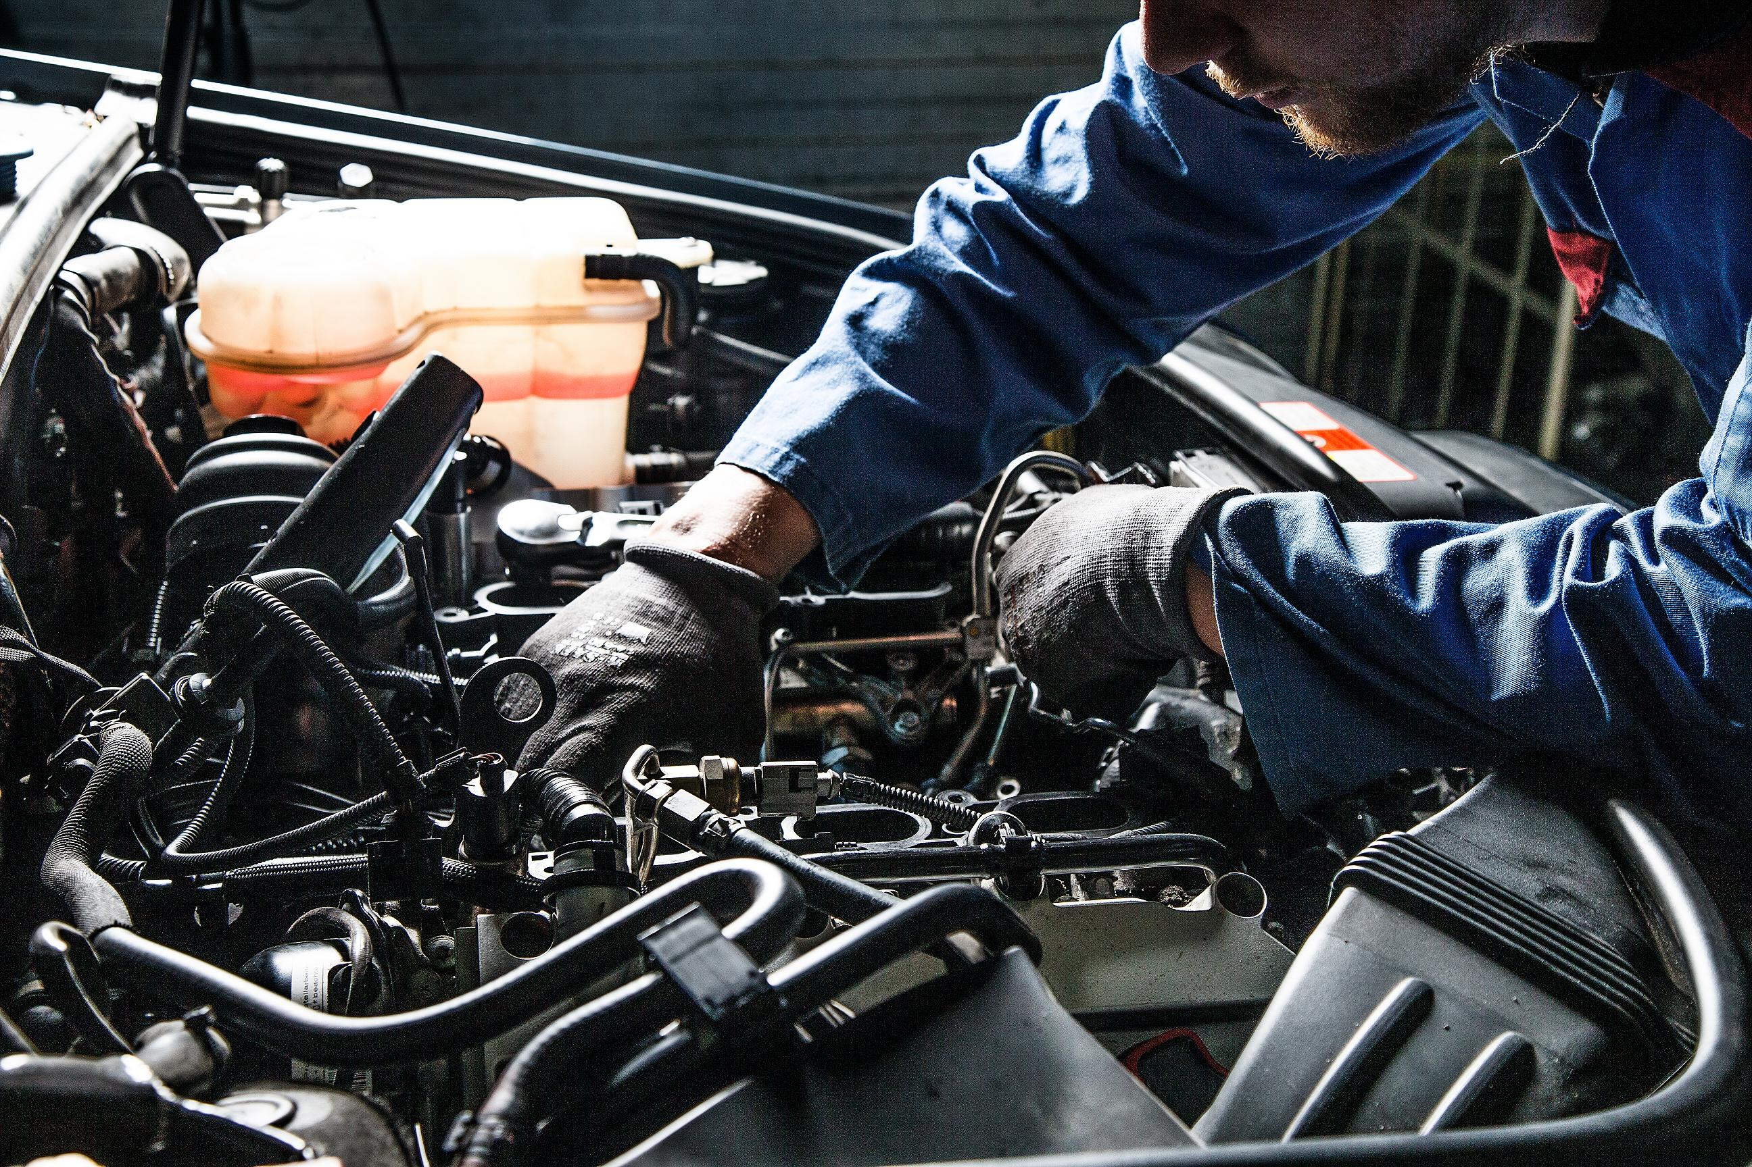
Save money

Slide 12
An interview with a bicycle dealer. Can you tell me something about your bicycle shop?
53 years ago.
Renovation.
Busy days and quiet days.
Summer season and winter season.
Secondhand bike.

Slide 13
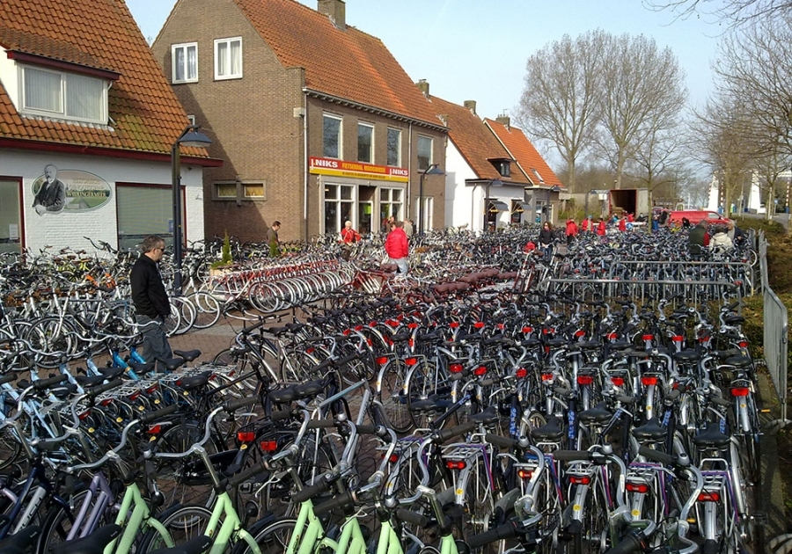
How does it work when you change your bike?

Slide 14
The job:
They have 12 employees
During the vacation they also have students working in the shop
Repair work
Office work
Transportation
testing bicycles
the supervisor

Slide 15
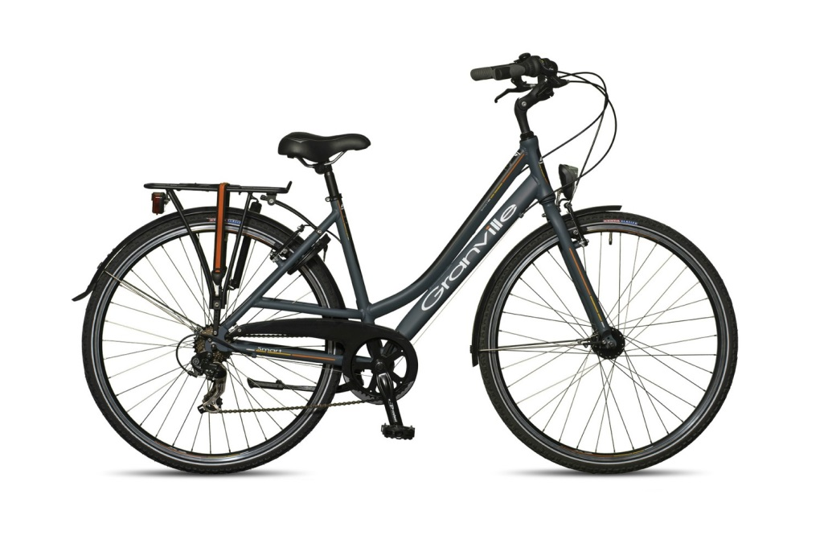
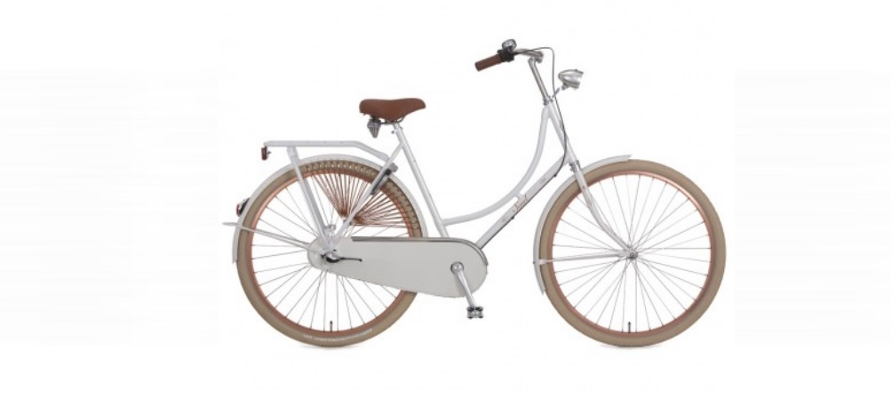
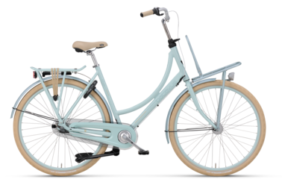
City bikes

Slide 16
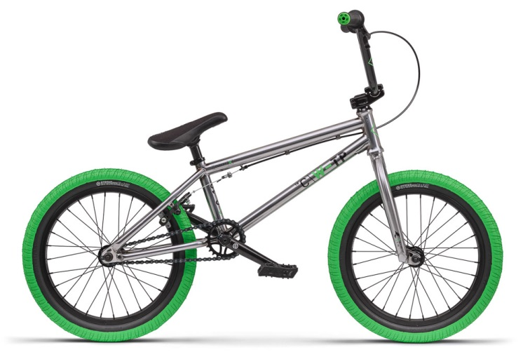
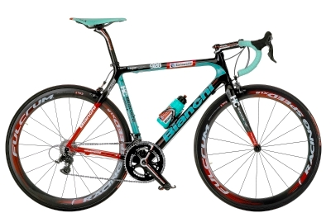
Sport bikes
BMX
Race bike

Slide 17
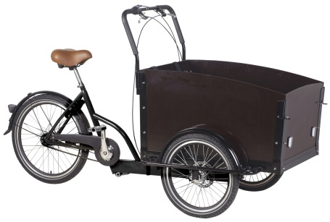
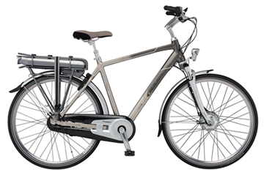
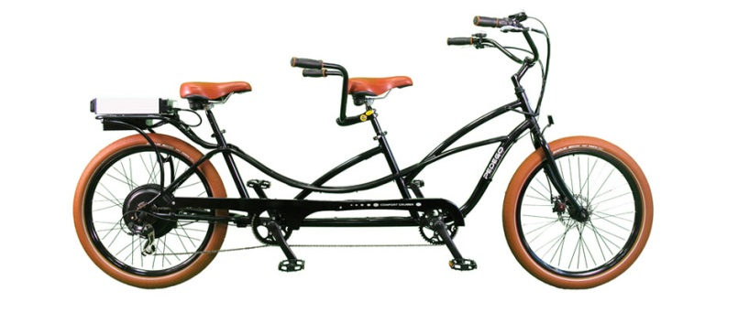
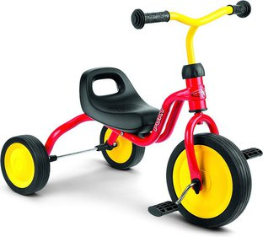
Other types of bicycles
Carrier bike
Electric bike
Tandem
Tricycle

Slide 18
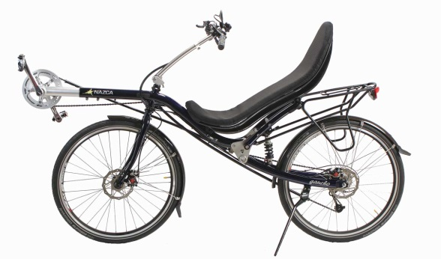
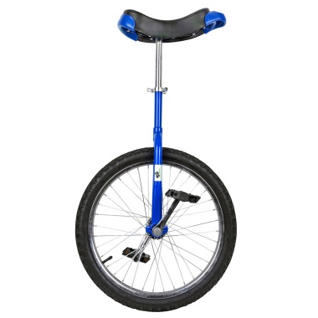
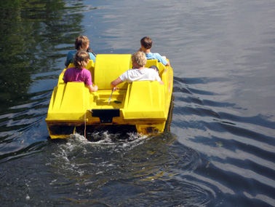
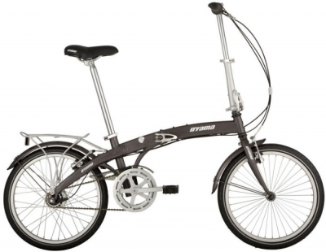
Other types of bicycles
Recument bike
Uncycle
Pedal boat
Folding bike

Slide 19
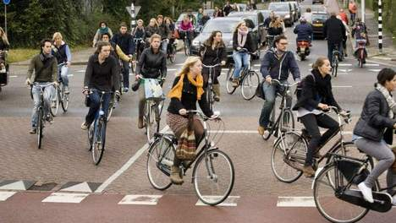
Why are there so many different types of bicycles?
Different goals
Popular
Young and old
Matching bicycles

Slide 20
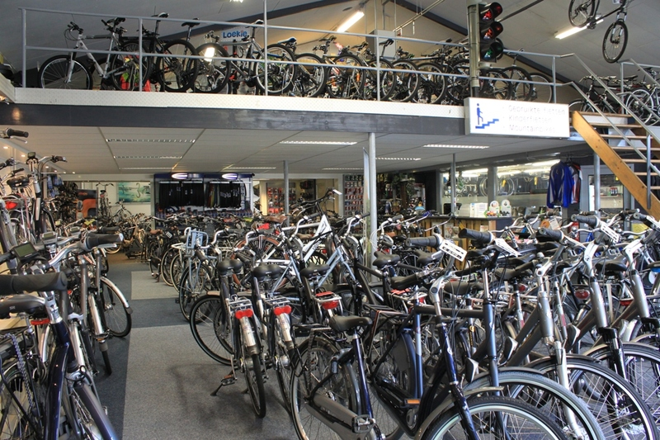

Slide 21
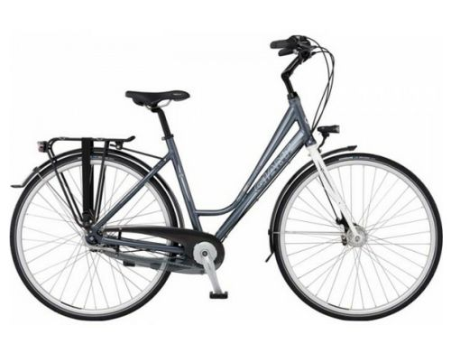
Which bicycle brands are from the Netherlands?
Gazelle
Sparta
Koga
Batavus
montego

Slide 22
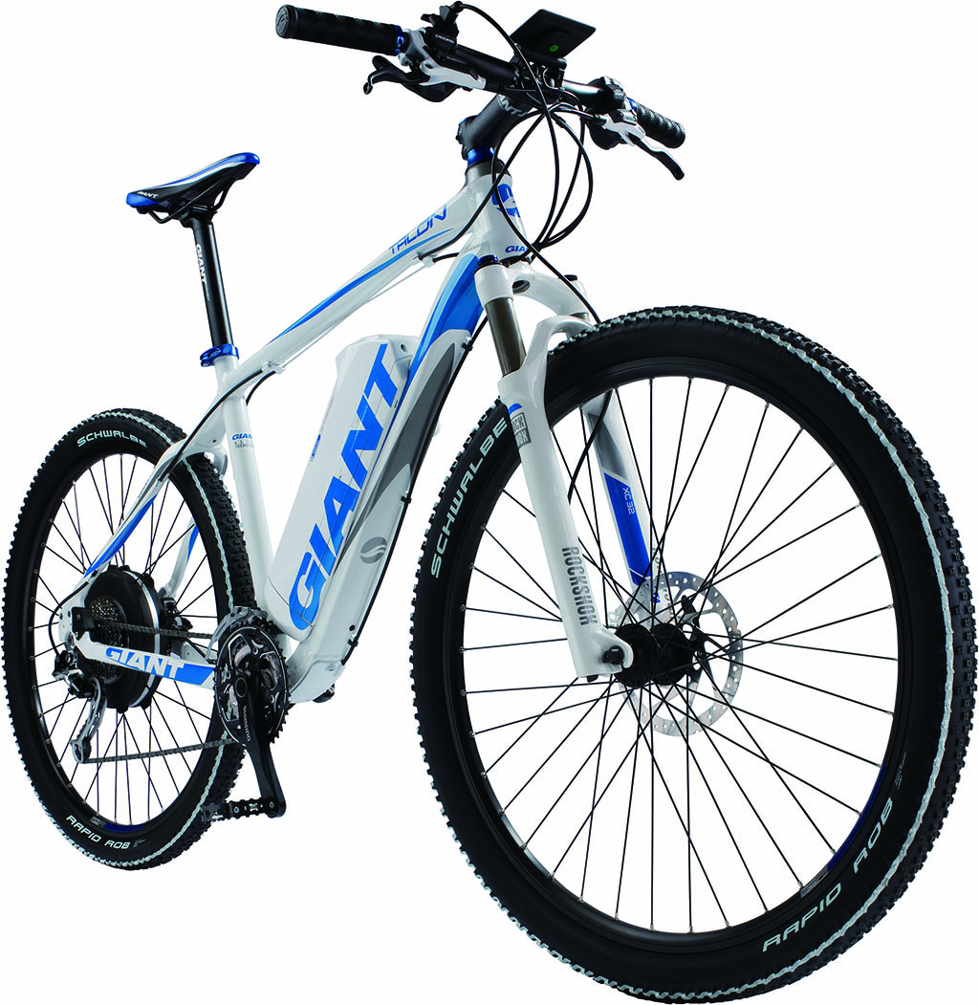
Which bicycle brands are famous all over the world?
Connondale
Trek
Giant
Cervelo

Slide 23
How many bicycle brands exist?
There are at least 500 bicycle brands in the world

Slide 24
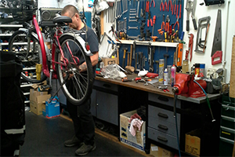
Are all the bicycles also made in the Netherlands?
Most of the bicycle dealers buy the bicycle parts all over the world and assemble all the parts in their workshop

Slide 25
Best Dutch cyclist.
Joop Zoetemelk is the best Dutch cyclist.
He is 69 years old.
He won the first big round in 1979.
Notes:
Joop zoetemelk is the best Dutch cyclist. He is 69 years old

Slide 26
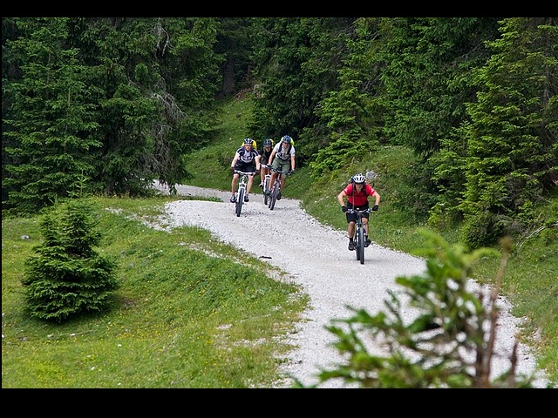
Notes:
In many countries in Europe, you often have to cycle at the road or at the sidewalk. Also in Romania, I saw on the internet.

Slide 27
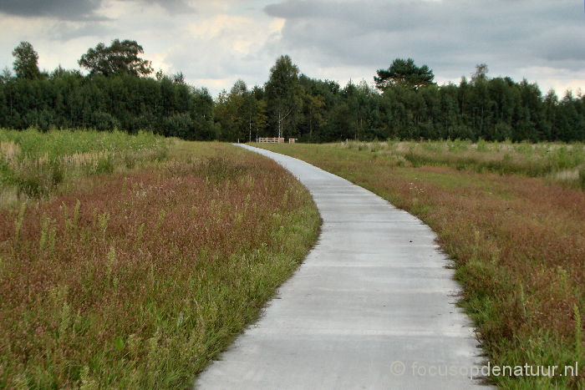
Notes:
But in Holland there are so many people who cycle. So there are almost everywhere cycle paths. In the nature they are very simple.

Slide 28
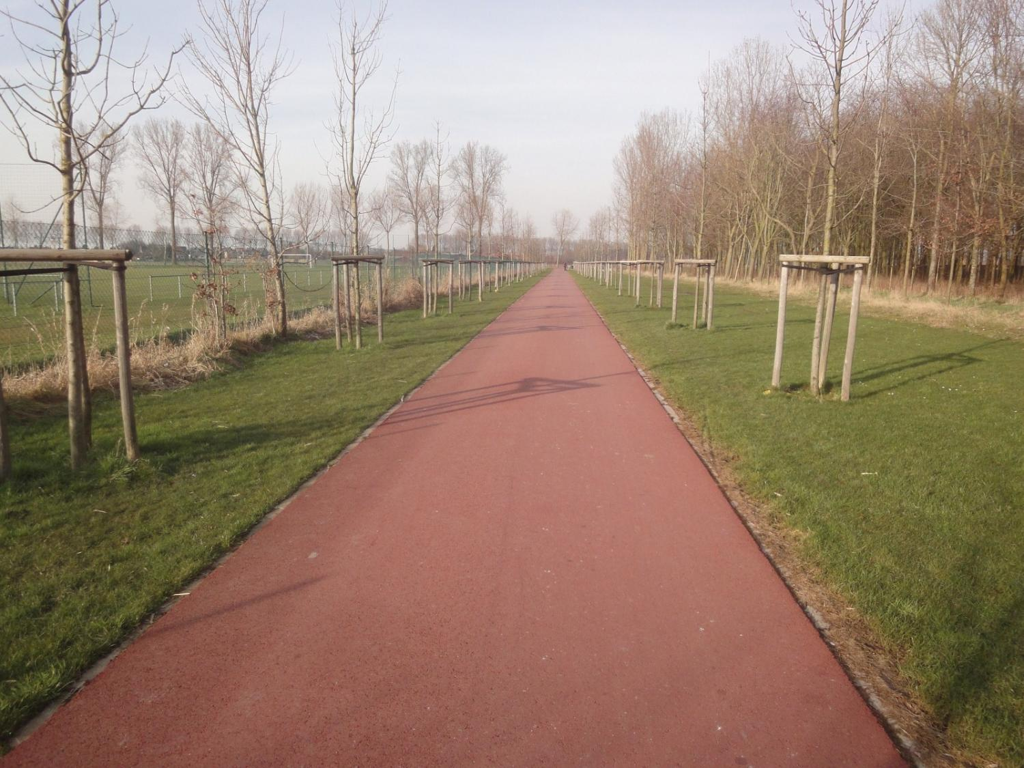
Notes:
Mostly they are made of little stones, broken shells or asphalt.

Slide 29
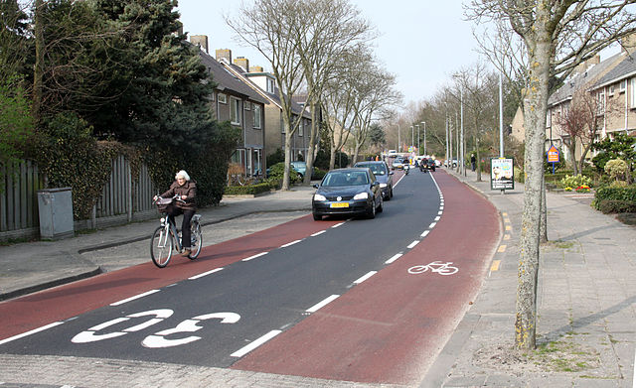
Notes:
In the city they are made of asphalt or tiles. In most cases there is a special cycle path. Sometimes it’s on the same road as the one for cars. Then there are stripes to seperate it from the part for the cars. And you can see the picture of a bike on it.

Slide 30
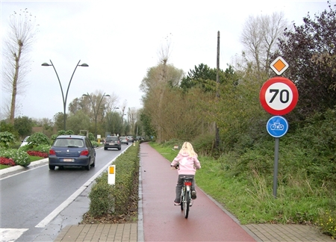
Notes:
And sometimes it’s seperate from the road with a piece of grass with trees or something like that. The most cycle paths are red or sometimes black.

Slide 31
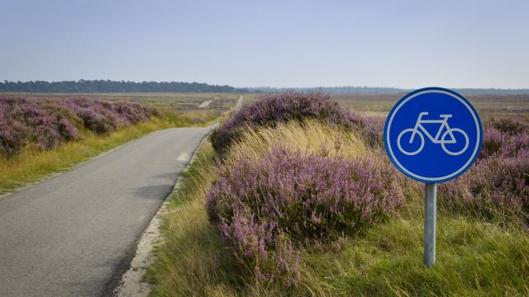
Notes:
There are blue road signs with a bike on it beside the path.

Slide 32
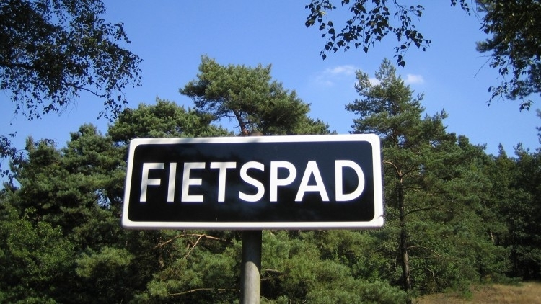
Notes:
Or with the word cycle path in Dutch on it.

Slide 33
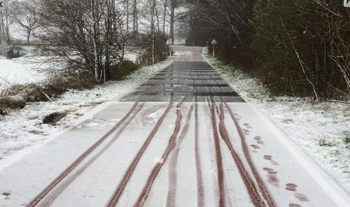
Notes:
At the moment, people are busy with an experiment for heated cycle paths.

Slide 34
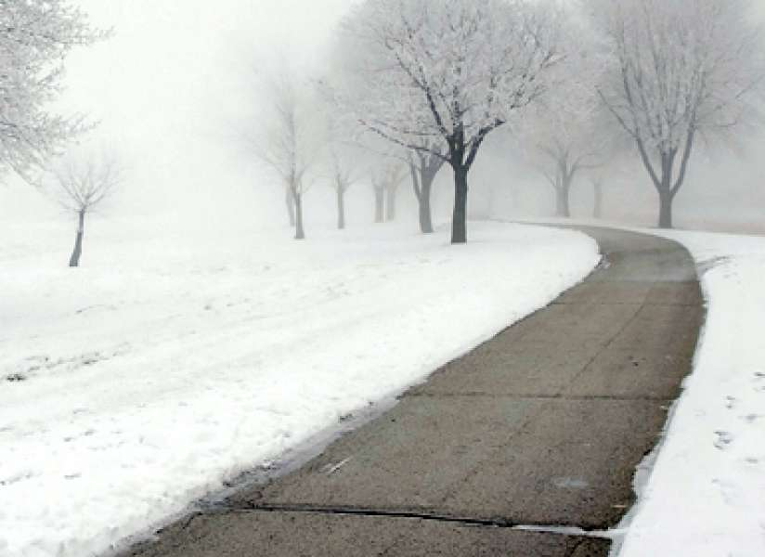
Notes:
It’s really handy, because when it’s snowing, the snow will melt right away .

