Slide 1
Introduction to Design
Alec Laing
17th October 2016

Slide 2
Objectives of the Workshop…
Introduction to Design
In 2 hours - to…
Give you an ideas of the Design Process
To introduce you to the idea of Rapid Prototyping – or getting your ideas down quickly
To introduce you to ACCESS-FM
To get you to use ACCESS-FM for a small project today
To show you some ways we Model, Manufacture and Test products
If we have time you can present some of your work back to the group

Slide 3
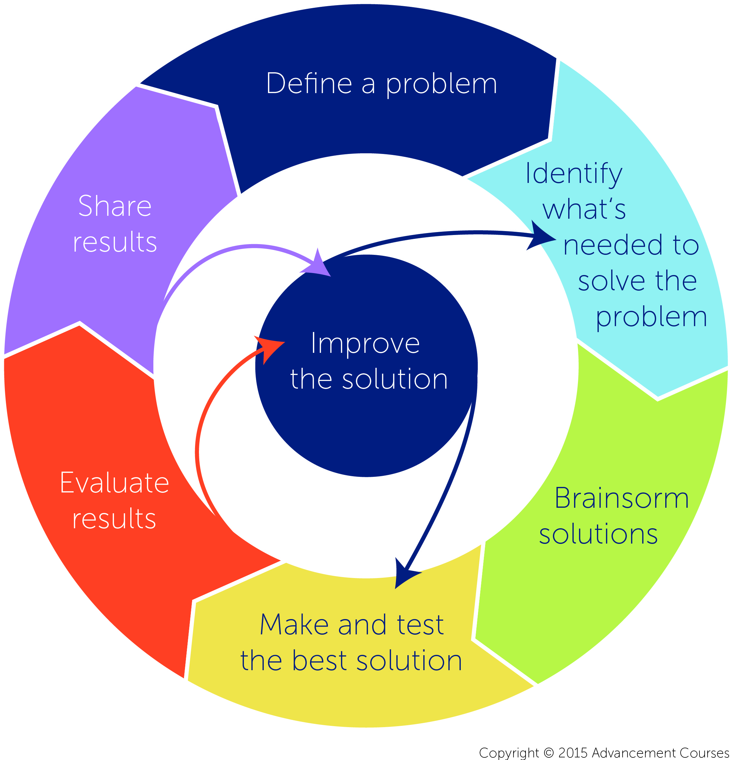
The Design Process

Slide 4
Introduction to Design
Rapid Prototyping

Slide 5
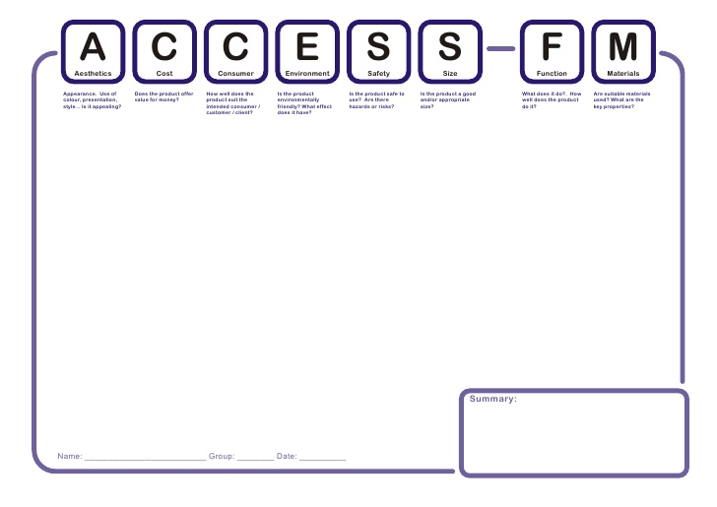
Access FM

Slide 6
The Problem

Slide 7
The Problem
http://www.babycentre.co.uk/a40/bathing-your-baby-safely

Slide 8
Internal Circuitry

Slide 9
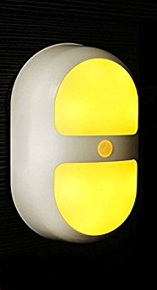
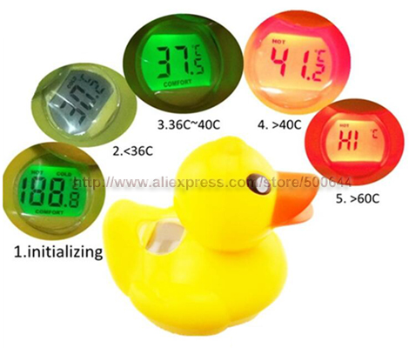
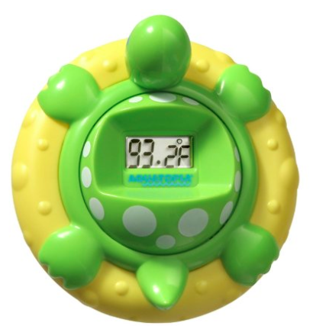
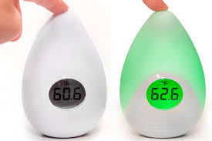
Existing Similar Products

Slide 10
Clay Modelling
Hyperlinks to Video
CAD Machining
Testing

Slide 11
Introduction to Design
Presentations

